Slide 1
Introduction to NumPy
By
Adnan Amin
Lecturer

Slide 2
Data-driven science (Data Science)
Effective data-driven science and computation requires understanding how data is stored and manipulated.
Datasets can come from a wide range of sources and a wide range of formats, including collections of documents, collections of images, collections of sound clips, collections of numerical measurements.
Remember:-
All data fundamentally as arrays of numbers.

Slide 3
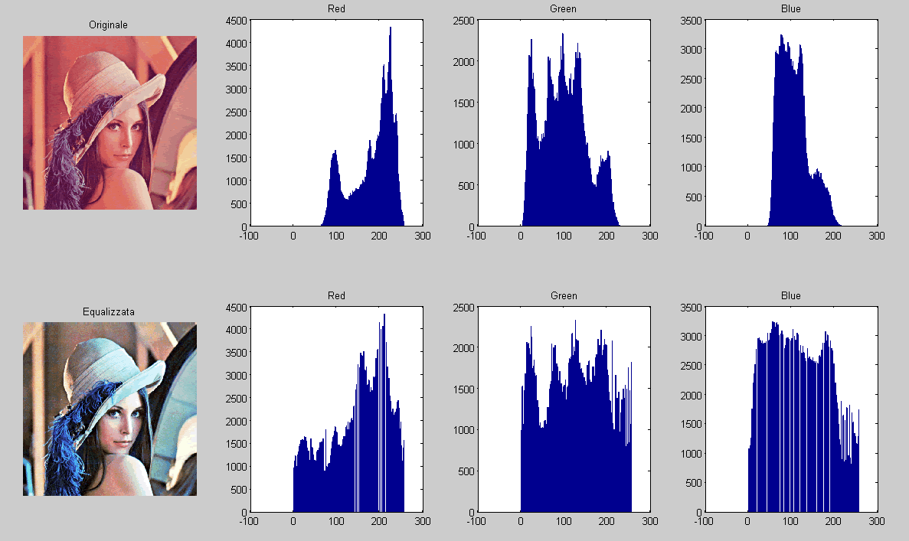
Images:
It can be thought of as simply two dimensional narrays of numbers representing pixel brightness across the area.
Image Source: Matlab

Slide 4
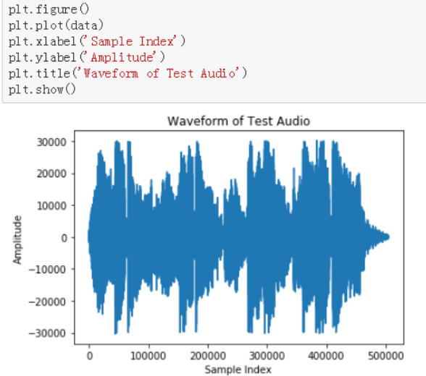
Sound Clips:
Sound clips can be thought of as one-dimensional arrays of intensity versus time.

Slide 5
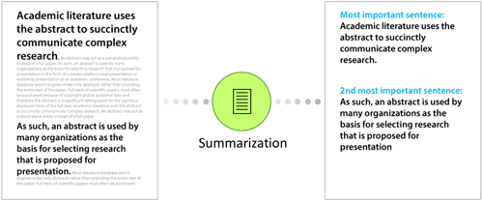
Text
Text can be converted in various ways into numerical representations, perhaps binary digits representing the frequency of certain words or pairs of words.
Source
Lexalytics

Slide 6
The first step in making them analyzable will be to transform them into arrays of numbers.
No matter what the data are:

Slide 7
Efficient storage and manipulation of numerical arrays is absolutely fundamental to the process of doing data science.
For example, Python has the NumPy package and the Pandas package

Slide 8
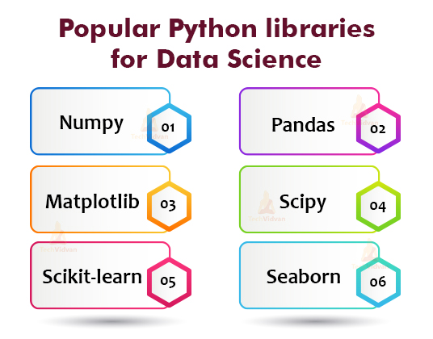
Numerical Python
numerical computation
Python data analysis
Scientific Python
Visualization
Collection of algorithms and functions
Machine learning
library
Visualization
Source: TechVidvan

Slide 9

NumPy (short for Numerical Python) provides an efficient interface to store and operate on dense data buffers (in memory).
NumPy arrays form the core of nearly the entire ecosystem of data science tools in Python.
import numpy as np

Slide 10
The Basics of NumPy Arrays
Attributes of arrays
Determining the size, shape, memory consumption, and data types of arrays
Indexing of arrays
Getting and setting the value of individual array elements
Slicing of arrays
Getting and setting smaller subarrays within a larger array
Reshaping of arrays
Changing the shape of a given array
Joining and splitting of arrays
Combining multiple arrays into one, and splitting one array into many

Slide 11
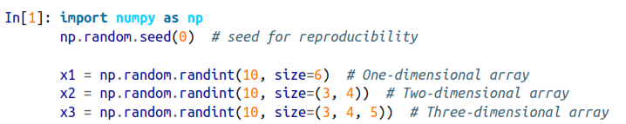
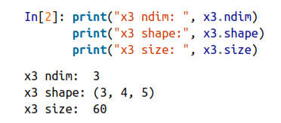

1. NumPy Array Attributes
Each array has attributes ndim (the number of dimensions), shape (the size of each dimension), and size (the total size of the array)

Slide 12
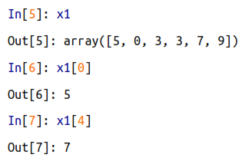
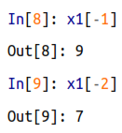
2. Array Indexing: Accessing Single Elements
In a one-dimensional array, you can access the ith value (counting from zero) by specifying the desired index in square brackets,

Slide 13
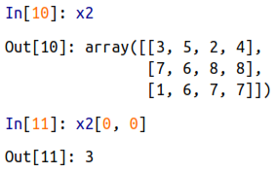
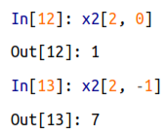
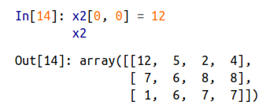
2. Array Indexing: Accessing Single Elements…
In a multidimensional array, you access items using a comma-separated tuple of indices:

Slide 14
3. Array Slicing: Accessing Subarrays
Just as we can use square brackets to access individual array elements, we can also use them to access subarrays with the slice notation, marked by the colon (:) character.
The NumPy slicing syntax:
x[start: stop: step]
If any of these are unspecified, they default to the values start=0, stop=size of dimension, step=1.

Slide 15
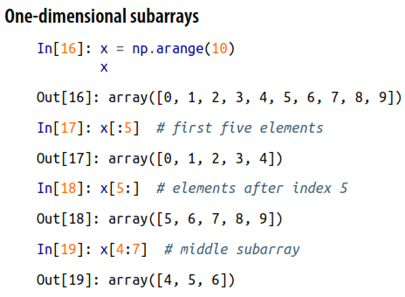
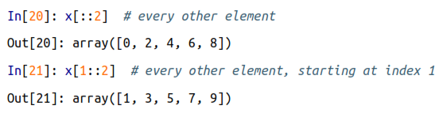
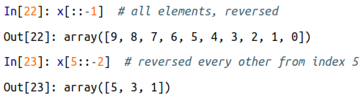
3. Array Slicing: Accessing Subarrays…

Slide 16
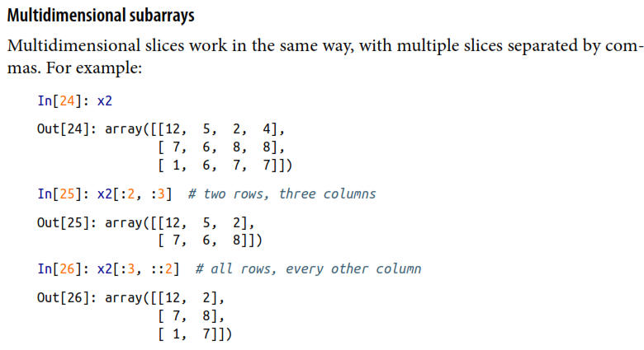



3. Array Slicing: Accessing Subarrays…

Slide 17
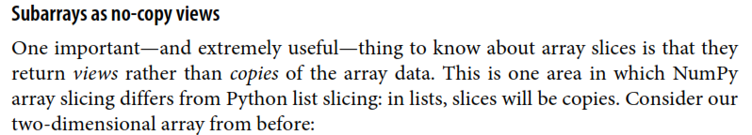
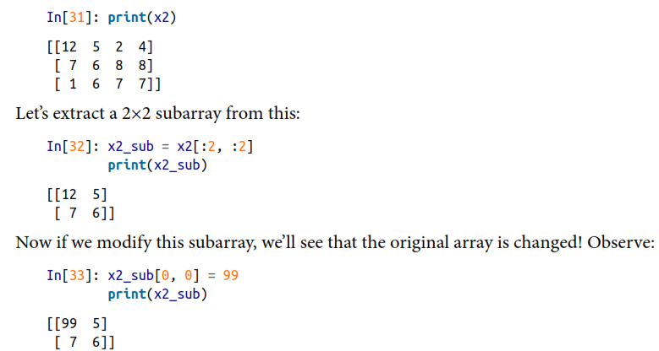
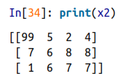
This default behaviour is actually quite useful: it means that when we work with large datasets, we can access and process pieces of these datasets without the need to copy the underlying data buffer.

Slide 18
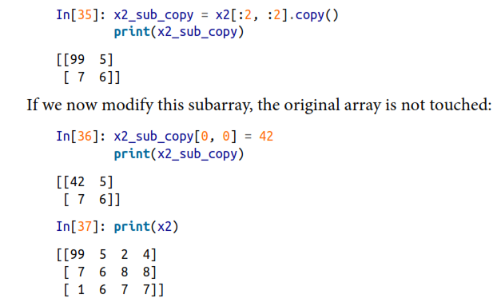
Creating copies of arrays

Slide 19
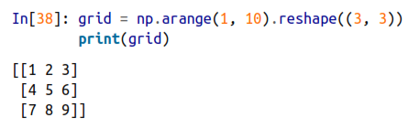
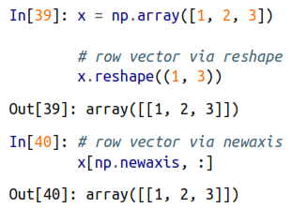
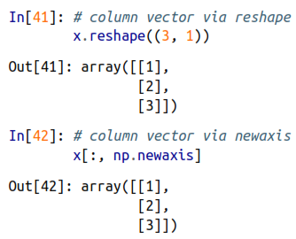
Reshaping of Arrays
the size of the initial array must match the size of the reshaped array.
the conversion of a one-dimensional array into a two-dimensional row or column matrix.

Slide 20
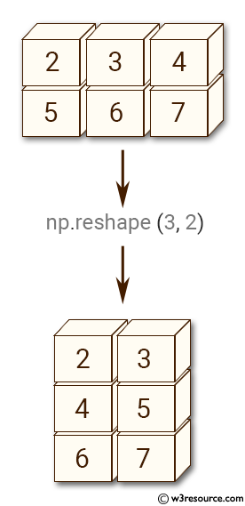
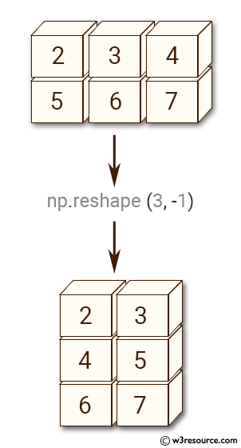
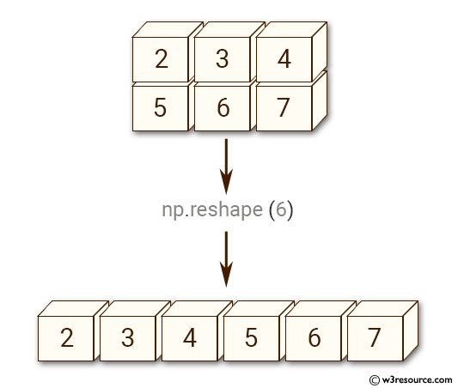

Slide 21
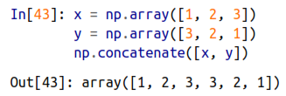
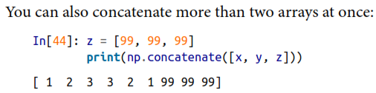
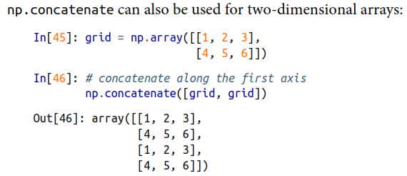

4. Concatenation of arrays

Slide 22
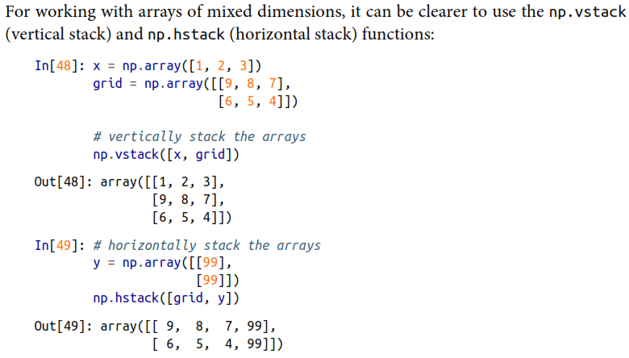

Slide 23
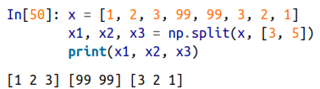
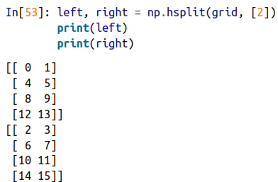
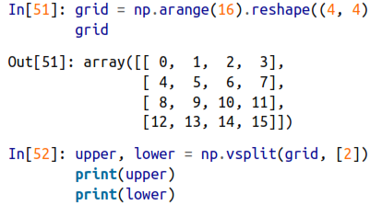


4.1. Splitting of arrays

Slide 24
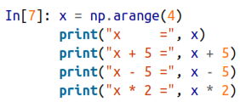
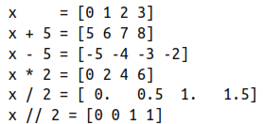

Exploring NumPy’s Ufuncs (universal functions )
Ufuncs exist in two flavors: unary ufuncs, which operate on a single input, and binary ufuncs, which operate on two inputs.
Array arithmetic (binary ufuncs):

Slide 25
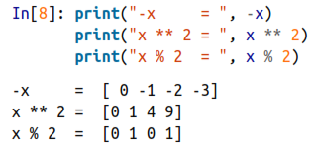
unary ufunc
a ** operator for exponentiation, and a % operator for modulus:

Slide 26
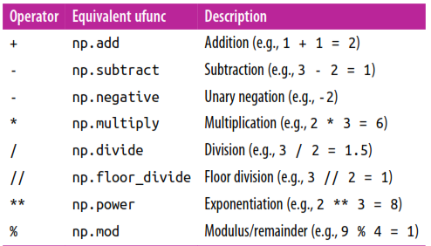
Arithmetic operators implemented in NumPy
In: x = np.arange(4) # 0,1,2,3
In: np.add(x, 2)
Out: array([2, 3, 4, 5])

Slide 27
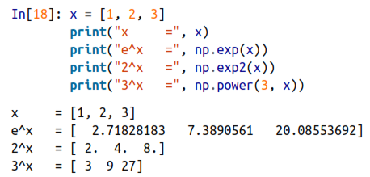
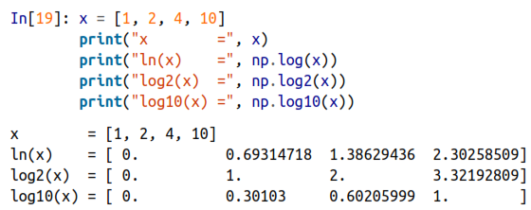
Exponents and logarithms

Slide 28
Computation on Arrays

Slide 29
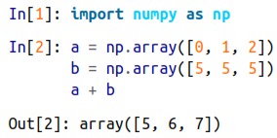

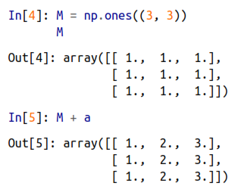
Broadcasting functions
Broadcasting is simply a “set of rules for applying binary ufuncs (addition, subtraction, multiplication, etc.) on arrays of different sizes.”
element-by-element basis: Broadcasting functions

Slide 30
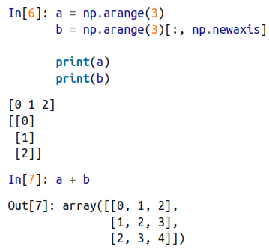
Broadcasting functions….

Slide 31
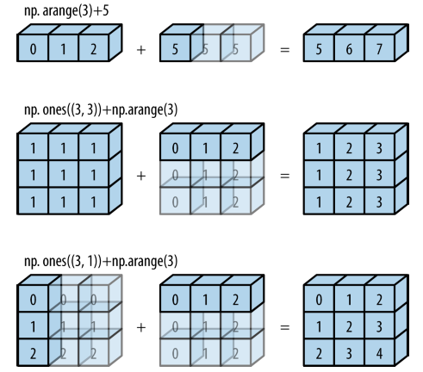

Slide 32
Rules of Broadcasting
Rule 1:
If the two arrays differ in their number of dimensions, the shape of the one with fewer dimensions is padded with ones on its leading (left) side.
Rule 2:
If the shape of the two arrays does not match in any dimension, the array with shape equal to 1 in that dimension is stretched to match the other shape.
Rule 3:
If in any dimension the sizes disagree and neither is equal to 1, an error is raised.

Slide 33

Broadcasting example 1
Let’s look at adding a two-dimensional array to a one-dimensional array:
Let’s consider an operation on these two arrays. The shapes of the arrays are:
m.shape = (2, 3)
a.shape = (3,)
Rule 1 says that the array a has fewer dimensions, so we pad it on the left with ones:
m.shape -> (2, 3)
a.shape -> (1, 3)

Slide 34

Broadcasting example 1…
By rule 2, we now see that the first dimension disagrees, so we stretch this dimension to match:
m.shape -> (2, 3)
a.shape -> (2, 3)
The shapes match, and we see that the final shape will be (2, 3):

Slide 35

Broadcasting example 2
Let’s take a look at an example where both arrays need to be broadcast:
Again, we’ll start by writing out the shape of the arrays:
a.shape = (3, 1)
b.shape = (3,)
Rule 1 says we must pad the shape of b with ones:
a.shape -> (3, 1)
b.shape -> (1, 3)

Slide 36
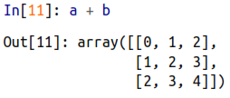
Broadcasting example 2…
Rule 2 tells us that we upgrade each of these ones to match the corresponding size of the other array:
a.shape -> (3, 3)
b.shape -> (3, 3)
Because the result matches, these shapes are compatible. We can see this here:

Slide 37

Broadcasting example 3
Now let’s take a look at an example in which the two arrays are not compatible:
The shapes of the arrays are:
m.shape = (3, 2)
a.shape = (3,)
rule 1 tells us that we must pad the shape of a with ones:
m.shape -> (3, 2)
a.shape -> (1, 3)

Slide 38
Broadcasting example 3…
By rule 2, the first dimension of a is stretched to match that of M:
m.shape -> (3, 2)
a.shape -> (3, 3)
Now we hit rule 3—the final shapes do not match, so these two arrays are incompatible, as we can observe by attempting this operation:

Slide 39


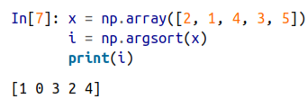
Arrays Sorting
# without modifying the input
# In-place
# The indices of the sorted elements

Slide 40
Thank you.
Reference Book:
Python Data Science Handbook,

